Slide 1
MARK XXIV (GEN-1)
S.A.P.P.H.I.R.E.
Stochastic Augmented Prolog Processing Helical Interfaced Robust Equipment
Project done and Presented By:
Panem Chaitanya Pavan Kumar
Settypalli Sujith Kumar
Balusupati Venkatesh
From:
Kalasalingam University

Slide 2
Problem Statement
To develop a Human Machine Interface which controls all devices and software associated to with help of gestures and Leap Motion.
To develop a device that allows users to navigate and control devices using hand movements.
Also to the solve the problem of lack of Virtual based Augmented reality available to interpersonally and socially connect with the devices and humans, which is mainly not used in the education, defense and health-care sector, which when implemented enables sustainable living.

Slide 3
Proposed solution:
In today’s world since we are totally surrounded by various gadgets and every device basically has a Human Machine Interface and a KERNAL OS, we develop a HMI based KERNAL control system in order to control every gadget as well as software associated to it by using various gestures and signs, for this can be incorporated in the technology of Smart Living, thus building a sustainable infrastructure community.
Also to develop a Augmented based Virtual Reality to solve the real life problems and to build a HMI with it in order to have a access to the solutions which are difficult to sustain in the real time environment.

Slide 4
Methodology:
This project will be developed using the technologies like Open Computer Vision and advanced Machine Learning concepts like GAN, CNN, etc., for them to be incorporated in an advanced Human Machine Interface, and currently the hardware connections along with the software integration, which is being developed by the core software scripting of advanced Python with the power of Prolog processing language, by which we will be trying to attain a multi-controllable KERNAL operating system, which when achieved will be used in order to gain control over every electrical/electronics/software (especially the medical devices and technologies) associated to the vivid technologies created.
With the technologies mentioned above, the Gesture based control systems can be enabled by and integrated through, for a lot of programs, software's and gadgets by changing the mode of integration thorough that and we could control a lot of different types of programs simply by using gestures, enabling Smart livelihood and created a sustainable infrastructure.

Slide 5
Addressing the challenges mentioned and finding a sustainable, ergonomic solution will result in the successful development of a well optimized gesture and sign based KERNAL optimized control system that enhances user interaction and user experience greatly and provides an intuitive and efficient alternative to conventional input methods
Such a system has the potential to revolutionize human-computer interaction and improve accessibility across various domains, including gaming, virtual reality, home automation, healthcare, and many more, thus creating a true Smart Living/Livelihood through a smart sustainable infrastructure community.

Slide 6
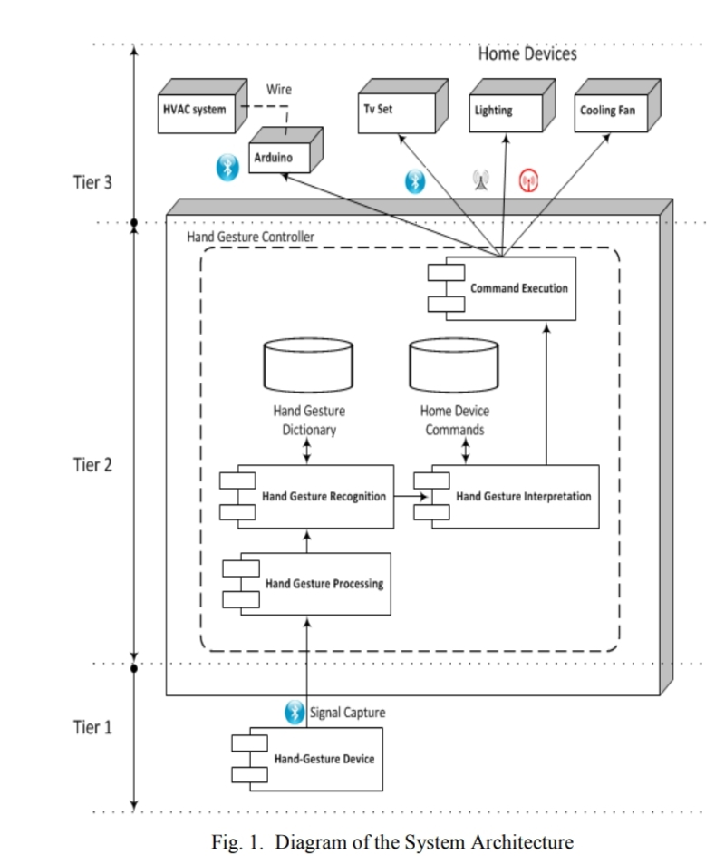

Slide 7
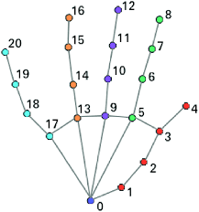
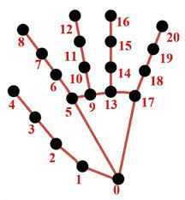

Hand Landmarks

Slide 8
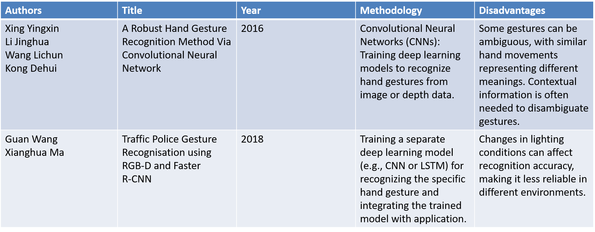
Literature Review of Available Journals

Slide 9
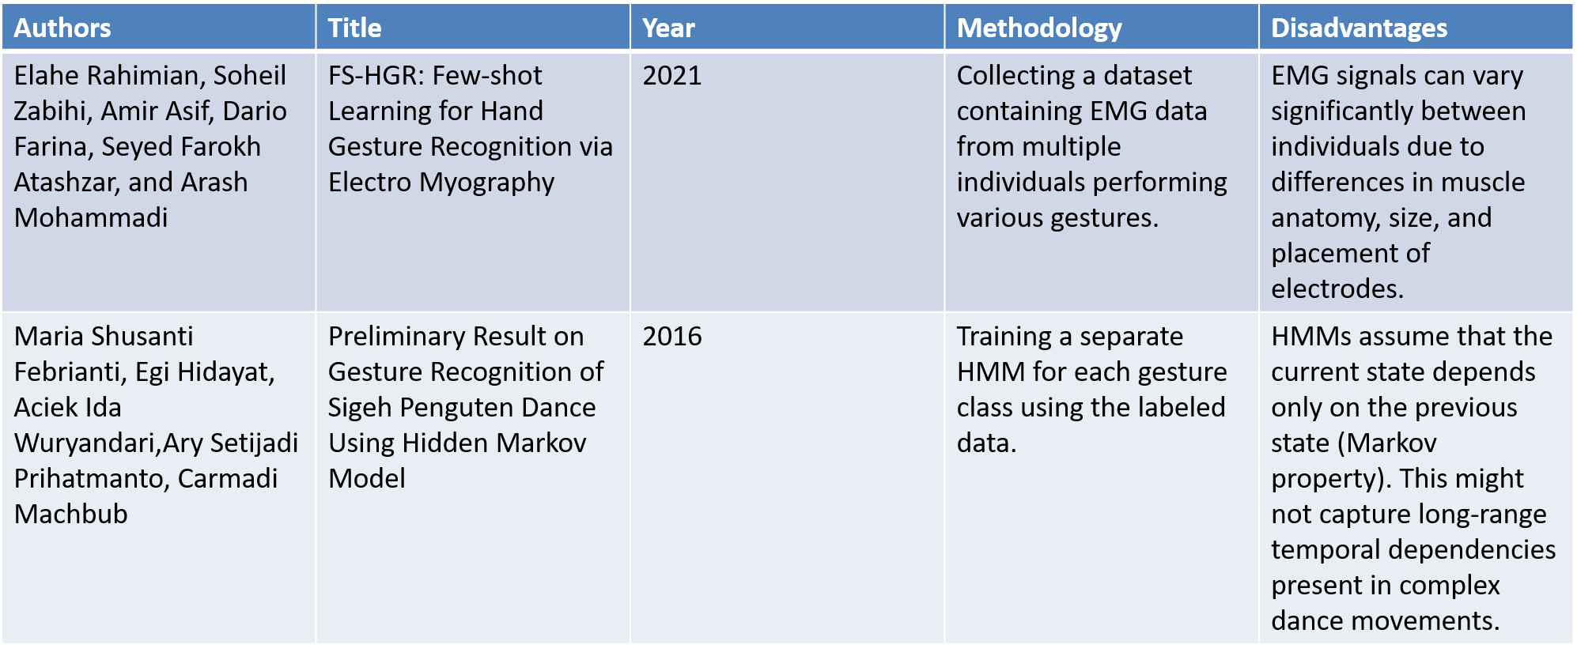

Slide 10
Novelty
The Novelty of this project is to designing and implement a gesture and sign based KERNAL optimized control system that allows users to interact with electronic devices and interfaces using hand and body movements (the gestures made and the signs shown) instead of traditional input methods such as keyboards, touchscreens or voice commands, so that the system will enable intuitive and efficient control, enhancing user experience (through it’s interface) and a large accessibility control across a wide range of applications and gadgets
However, several challenges need to be addressed to ensure the successful development and deployment of this technology which are:
Gesture Recognition Accuracy
Real-Time Responsiveness
Gesture Sets and Customization
Scalability and Adaptability
User Learning Curve
Robustness and Reliability

Slide 11
Sustainable Development Goals
Good Health and Well-Being
Decent Work and Economic Growth
Industry Innovation and Infrastructure
Sustainable Cities and Communities

Slide 12
Future Scope
Enhanced Human-Computer Interaction: Hand gesture recognition will play a significant role in making human-computer interaction more intuitive and natural. Users can control devices and interfaces without physical contact.
Healthcare Applications: Gesture recognition can aid in touchless control of medical equipment, making it safer for healthcare professionals and patients.
Sign Language Interpretation: Advanced systems can help bridge communication gaps for the hearing-impaired by recognizing and translating sign language gestures.
Smart Home Control: Home automation systems can be controlled with gestures, making it easier to manage smart appliances and systems

Slide 13
Thank You

